Slide 1

E-School
Architectural Design

Slide 2
Mercury
What is E-School?
E-school is an online-based educational platform which will provide a learning environment to the students and ensure the academic experience virtually to both students and teachers.
02
Mercury
Mercury is the closest planet to the Sun
03
Saturn
It’s composed of hydrogen and helium

Slide 3
Authentication
Admin
Login
Authentication
Account
Creation
Teacher
Student

Slide 4
Usage Scenario
Admin
Authenticity Verification Handling Academic Activities
Teacher
Assigned Course Tiles Materials Management
Exam and Assignments Inquiries
Student
Course Tiles Materials Section Exam and Assignments Result and Performance Inquiries

Slide 5
Design Steps
01
02
03
04
ACD
Archetype
Top Level Components
Instantiation
Show the interactions between a system and external factors
Generic model of important components in a system
ACD is decomposed into high-level components
Each component is decomposed further along with relevant Architectural Patterns

Slide 6
Actors
01
Architectural Context Diagram
Superordinate systems
02
Subordinate systems
03
Peer-level systems
04

Slide 7
Subordinate Systems
Actors
Admin
01
Zoom Video Conference
01
02
Teacher
02
Email Service
03
Student
03
03
Google Form

Slide 8
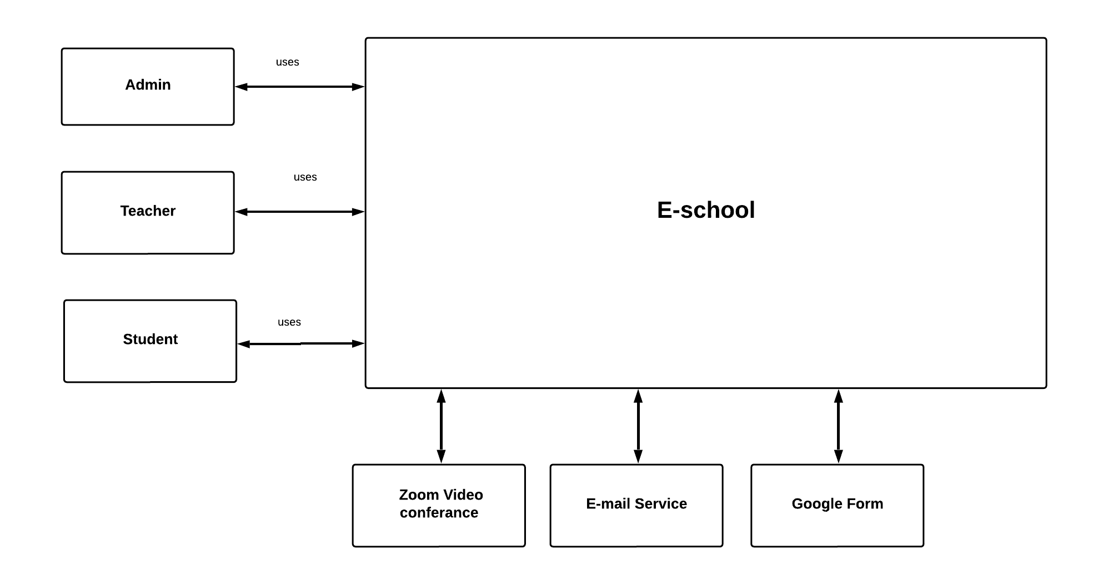
Context
Diagram

Slide 9

Archetypes
An Archetype is a class or pattern that represents a core abstraction of the design of an architecture of a system

Slide 10
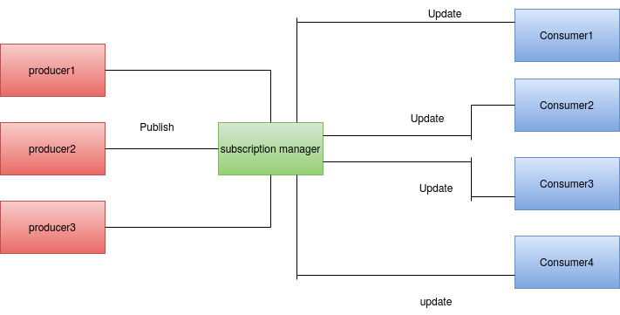
Decouple Message propagation & Consumption
Publisher-Subscriber
Used by :
Email Subscription
Course Stream

Slide 11
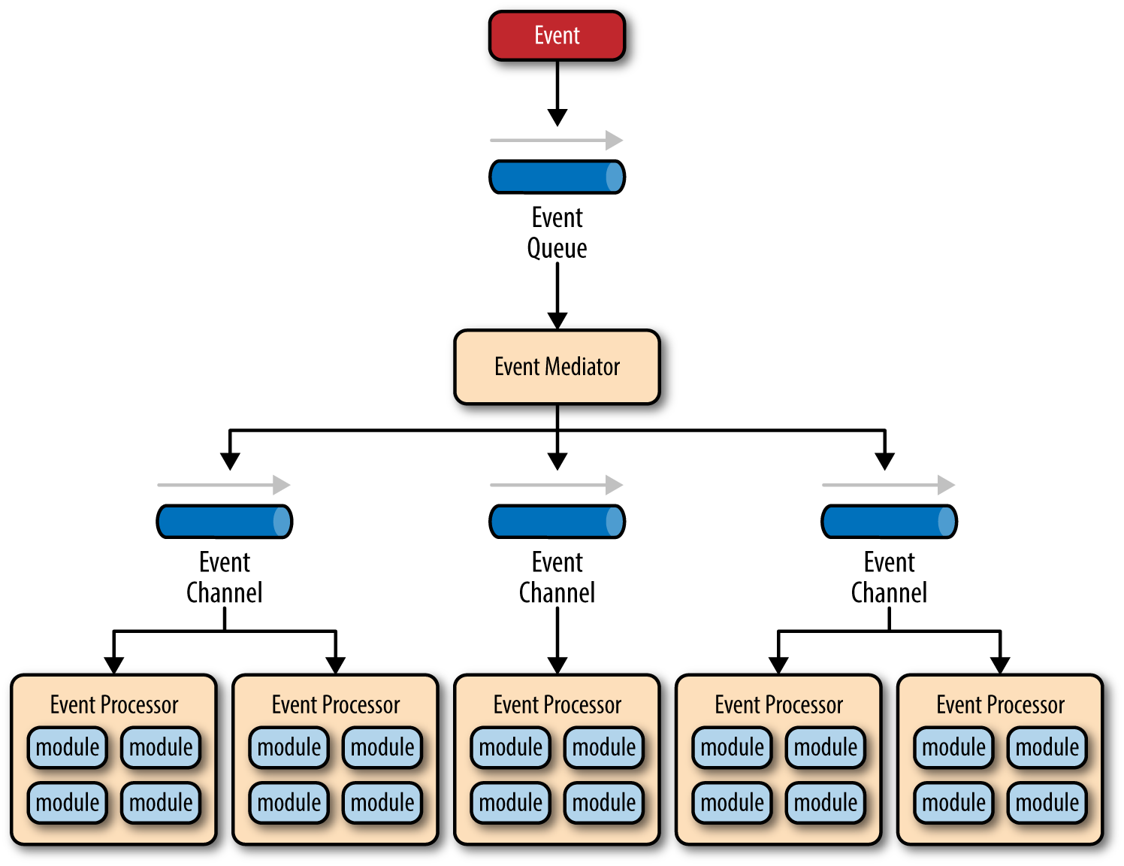
Handle independent asynchronous events
Event-Driven
Used by :
Evaluation System
Exam & Assignment Management
Course Materials

Slide 12
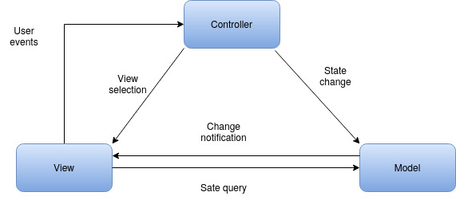
Decouple Data Model, Presentation & Control
MVC
Used by:
Authentication
Sign Up
Sign In
Course Management
Course Stream
Evaluation System
Exam Management
Assignment Management

Slide 13

TOP LEVEL
COMPONENT
Top Level Components can be derived through analysis of the Application Domain and Infrastructure Domain.
Application Domain - Requirements Model (SRS)
Infrastructure Domain - Implementation Details

Slide 14
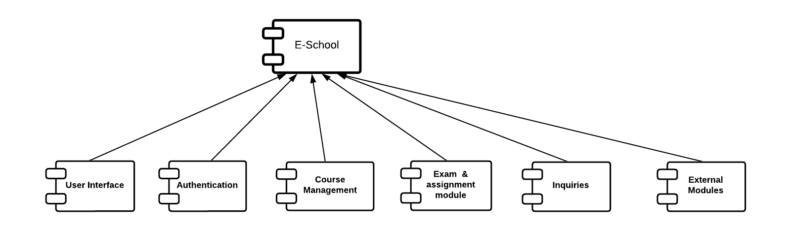
TOP LEVEL COMPONENTS

Slide 15

Instantiation
Instantiation is the iterative refinement of high-level Components.

Slide 16
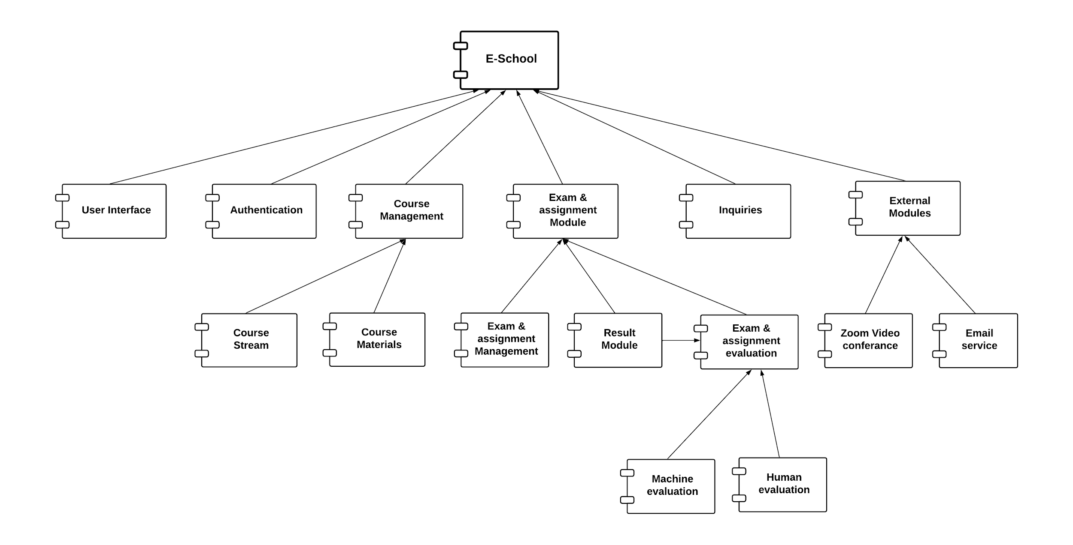
INSTANTIATION
INSTANTIATION

Slide 17

Any Questions?

